Slide 1
Database Applications Building Web Sites with Django – SI664
Dr. Charles Severance <csev@umich.edu>
Edward Platt - elplatt@umich.edu
Yujie Chen (Ella) - ellachen@umich.edu

Slide 2
Face to Face Meeting Recordings
The face to face lectures and discussions will be recorded for those who cannot attend. Links to the recordings will be provided in Canvas. These recordings will be kept private and will only available for a few weeks. The recordings are not retained or archived for a long time. Students who miss class should view the recordings before they are no longer available.

Slide 3
Covid Protocols
Everybody must be be vaccinated
Use the ResponsiBlue app
All wear masks indoors – including teachers
Eating is not OK
Brief drinking is OK
It is always OK to leave the room – any time
We will take breaks every hour of lecture
I have tried to find larger rooms than necessary to allow for some social distancing

Slide 4
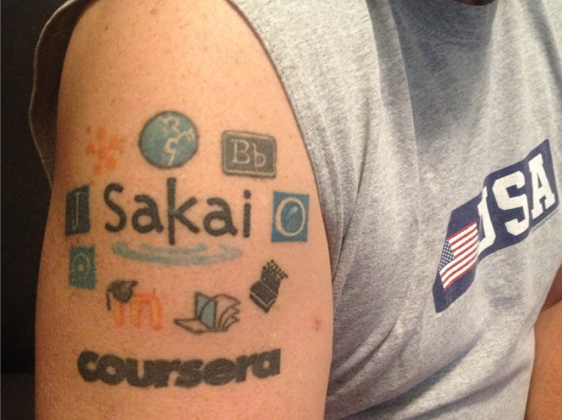
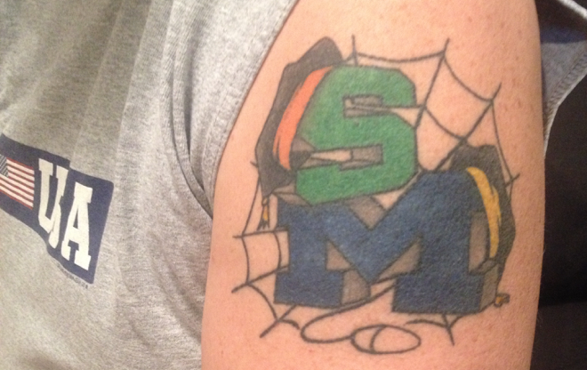
http://www.dr-chuck.com/
Twitter: @drchuck

Slide 5
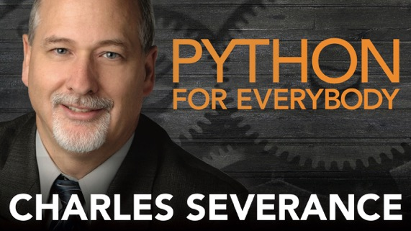
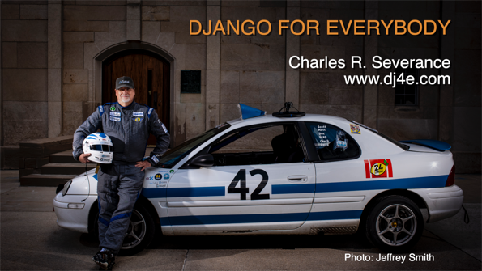
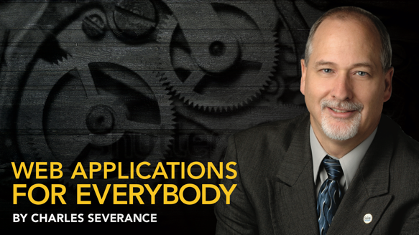

Slide 6
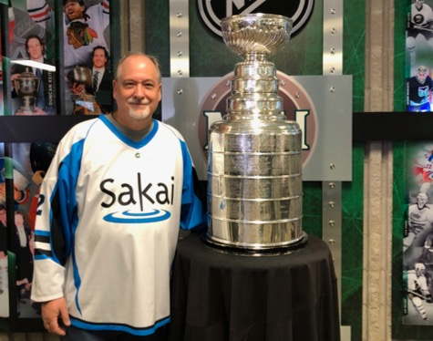
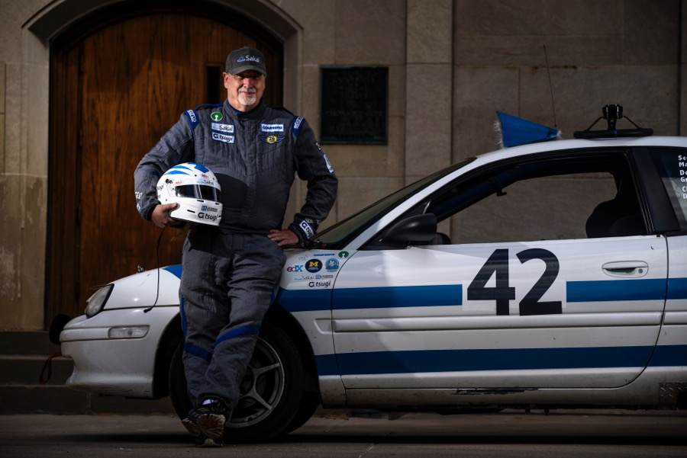
@SakaiCar

Slide 7
Enrollment?
Usually we spend the first week of this class adjusting enrollment
Different this semester
UMSI Wait list process
Covid
Expanding enrollment caps

Slide 8
Course Overview

Slide 9
SI664 in the Curriculum
SI506 – Learn Python
SI507 – Moar Python
SI539 – Front-End / Design / Accessibility
SI664 – Back End / Database / Web Protocols
SI579 – Advanced Front Ends Mobile (i.e React)

Slide 10
Pre Requisites
Confident Python Programmer – Including Object Orientation
Nice to have
HTML / CSS – Can construct markup
JavaScript – Should be basically competent
SQL – Should have seen C.R.U.D. and basic foreign keys
First week's assignments – review / catchup

Slide 11
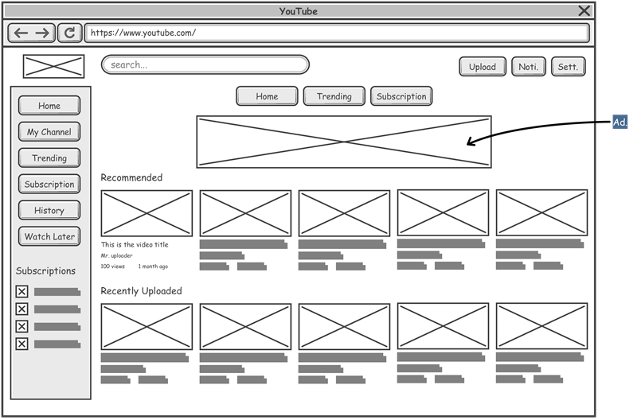
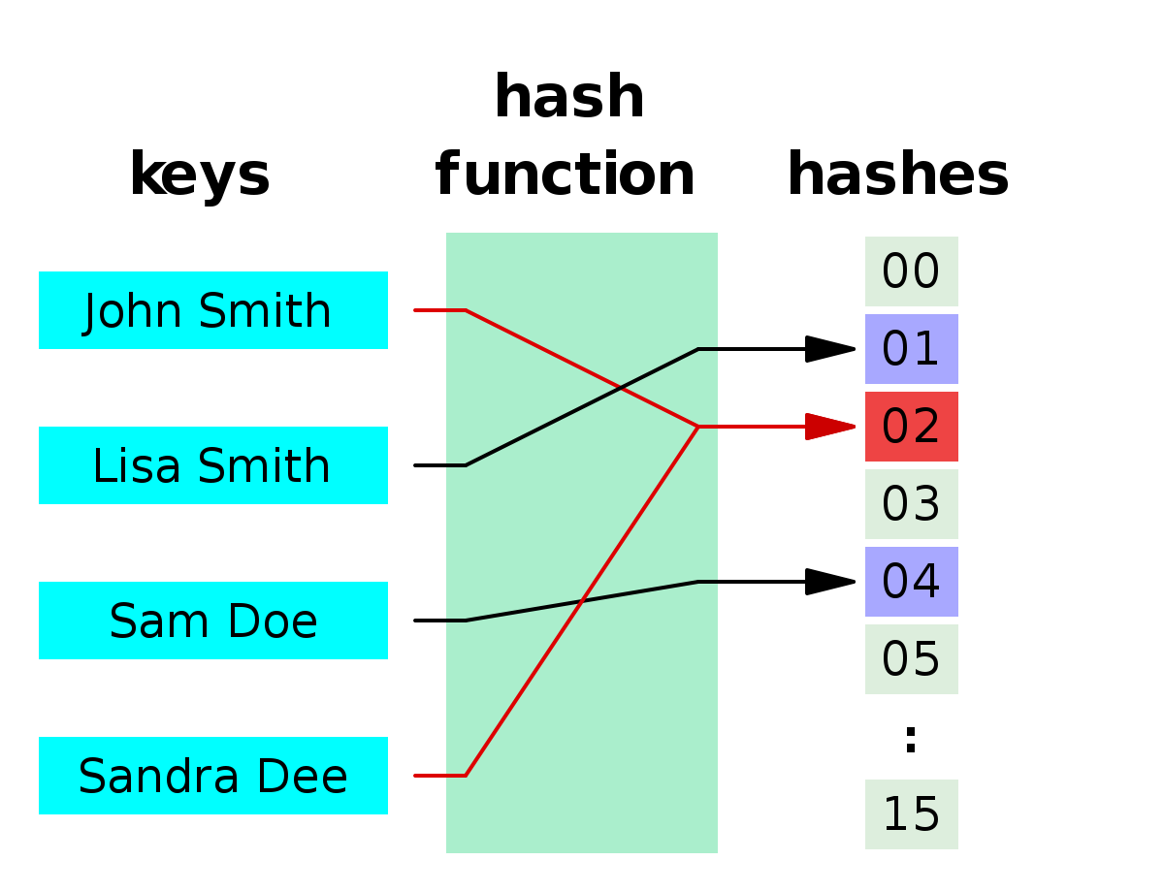
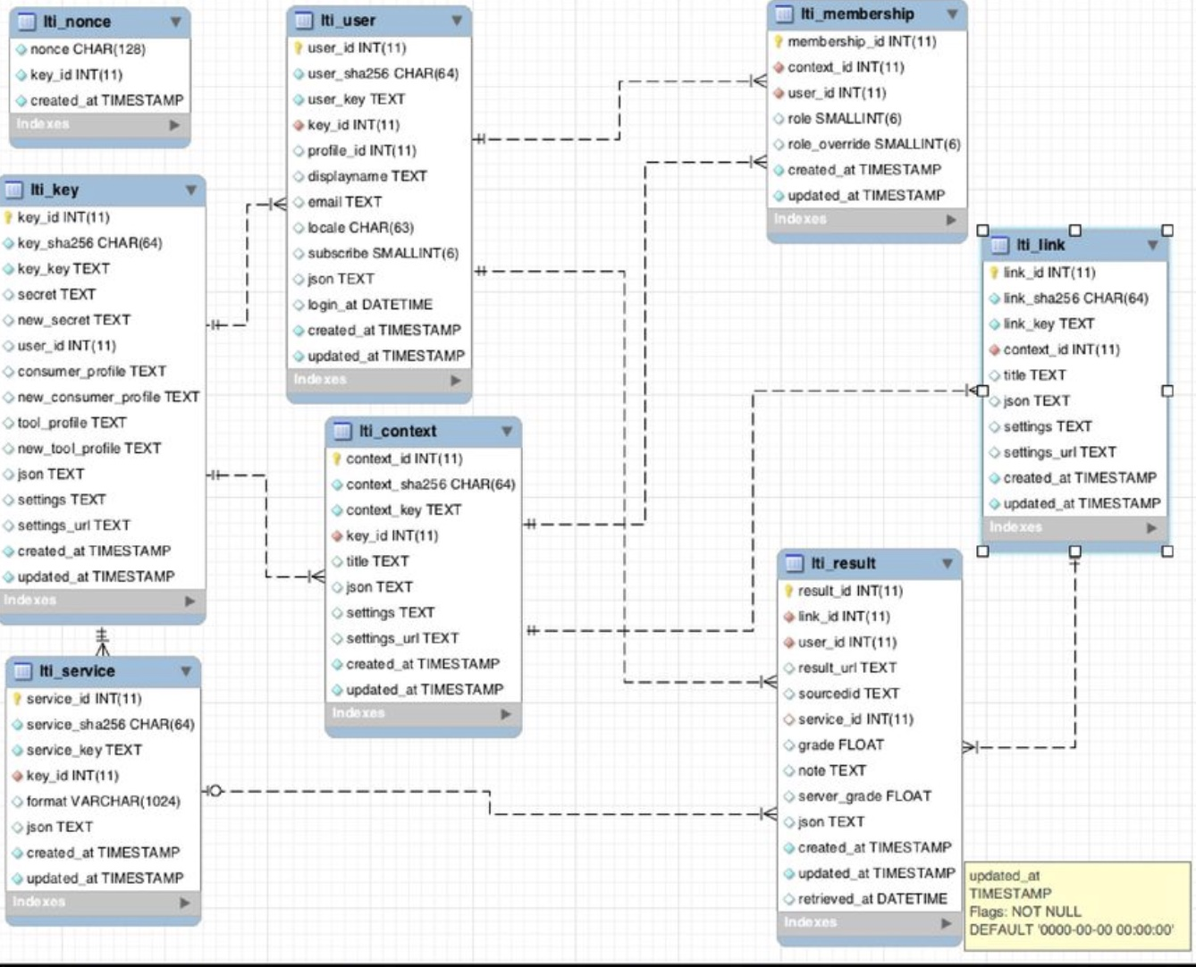
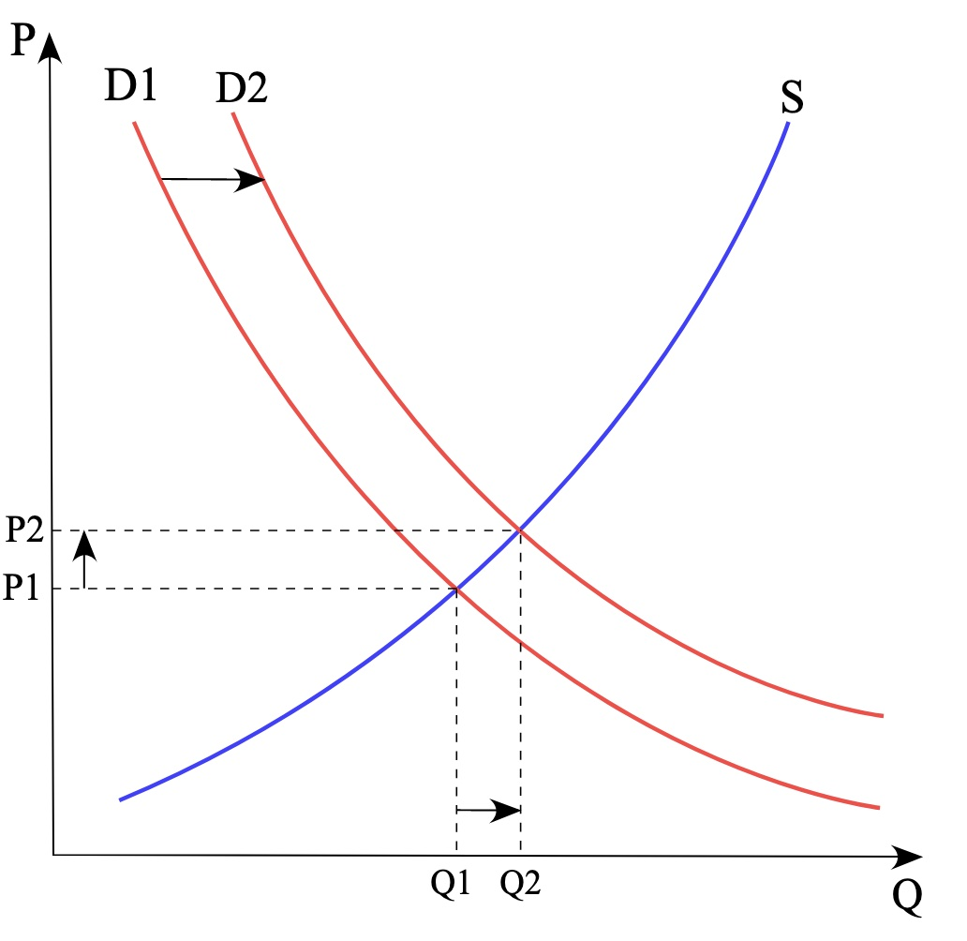
Why Do *I* Need to Learn Django?
Computer Science
HCI
Data Science
Economics

Slide 12

SQL
Django
Model
View
Controller

Slide 13
What is the Course About?
Able to quickly build and deploy Minimum Viable Product (MVP) web sites using Django

Slide 14
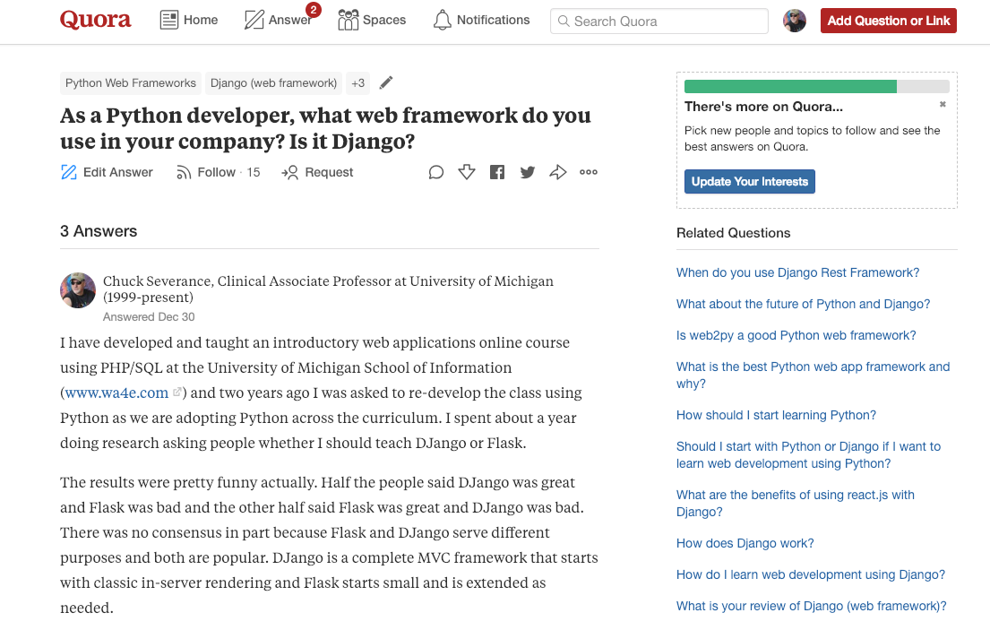
https://www.quora.com/As-a-Python-developer-what-web-framework-do-you-use-in-your-company-Is-it-Django

Slide 15
Learning Objectives
What *is* a web application and how to they function
Relational Models / Data base Design
Django as Model View Controller pattern
Building and using REST APIs
JavaScript / JQuery /AJAX
Ready to learn on your own...

Slide 16
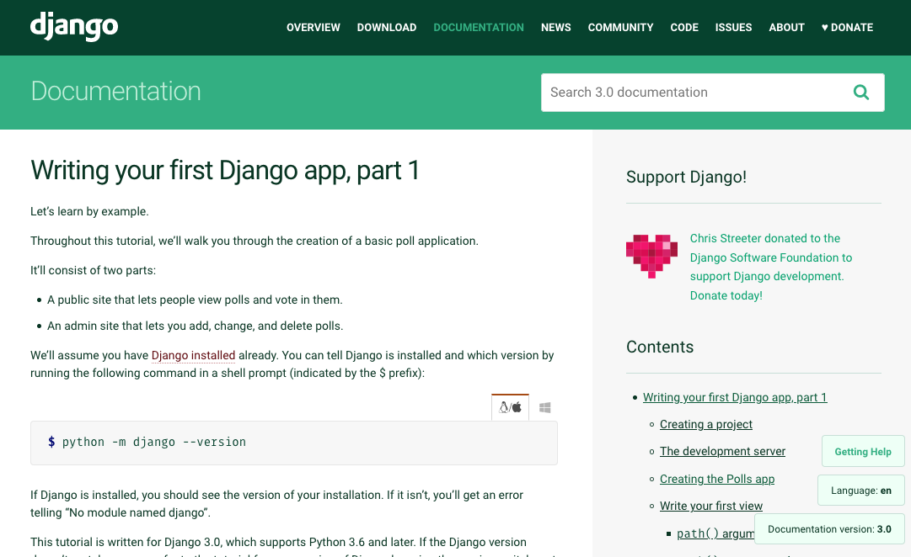
No Textbook

Slide 17
Don't Fall Behind in this Class
Learning to program – especially in a framework like Django is non-linear
If you don't understand what is covered in "Week 4" – then "Week 5" will be very foggy – and "Week 6" will make no sense at all
There is no way to drift along and then burn the midnight oil right before the exam.
The course material is only moderately difficult
It is very easy to get profoundly confused – at which point – get help from discussion or office hours – don't fall behind

Slide 18
From: Charles Severance <csev@umich.edu>
Subject: My Plus branch work is stuck - my component won't come up in Sakai
Date: January 4, 2022 at 6:36:00 PM EST
Earle / Adrian, I am dead in the water. I have been building plus/impl based on conversations/impl - up until yesterday I was just building utility code, models, and services and unit testing extensively.
I now want to run the Service in Sakai as a component - and Sakai barfs with the following message:
o.s.u.SakaiApplicationContext.refresh Exception encountered during context initialization - cancelling refresh attempt: org.springframework.beans.factory.BeanCreationException: Error creating bean with name 'org.sakaiproject.plus.api.LaunchService': Lookup method resolution failed
And of course things go way downhill after that. I have triple checked things like typos and done a bunch of comparison with the conversations impl - with no luck. I am using the components.xml in the unit testing just like you showed me - and it works great - but it seems not to come up when the component in Sakai.
I am dead in the water on plus at this point. :(
Thanks in advance.
/Chuck

Slide 19
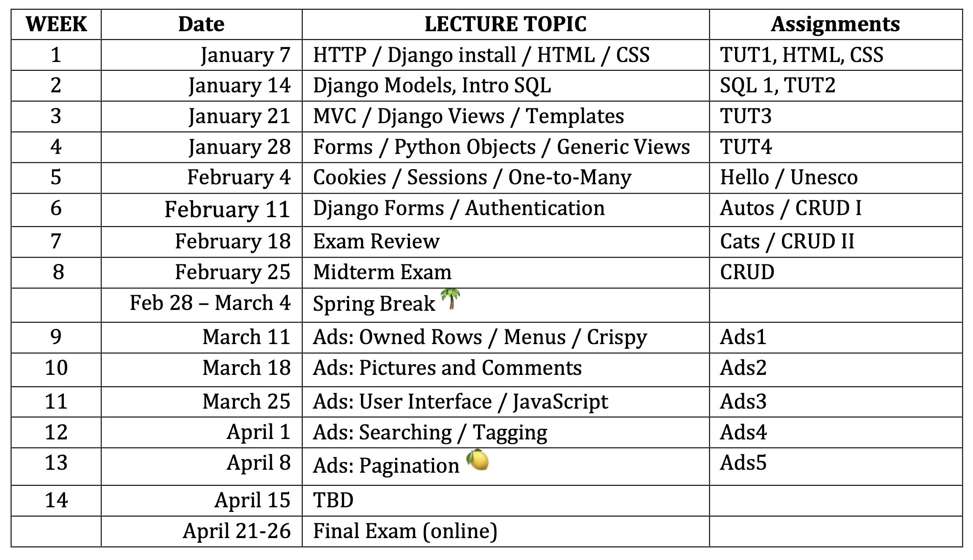

Slide 20
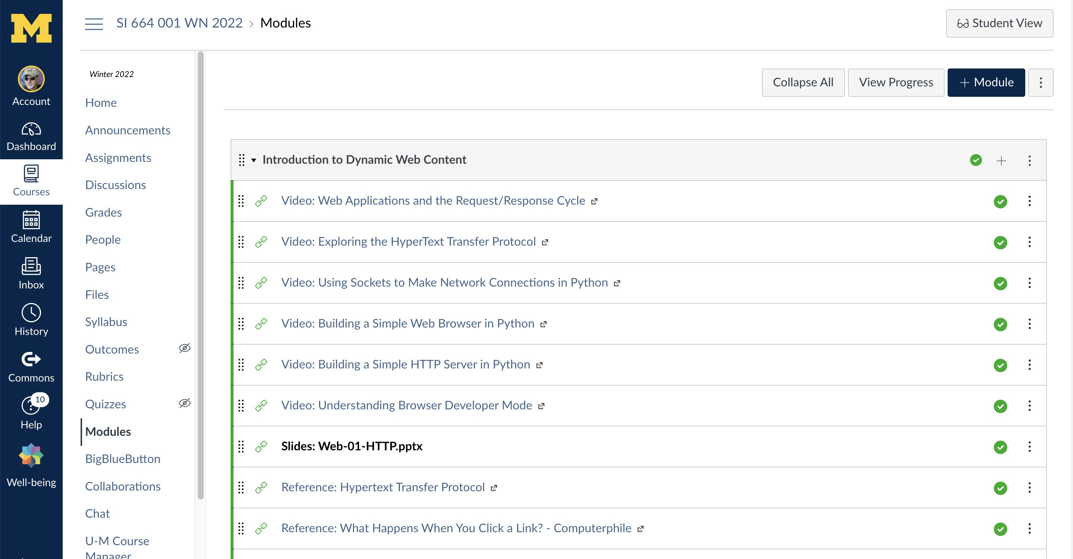

Slide 21
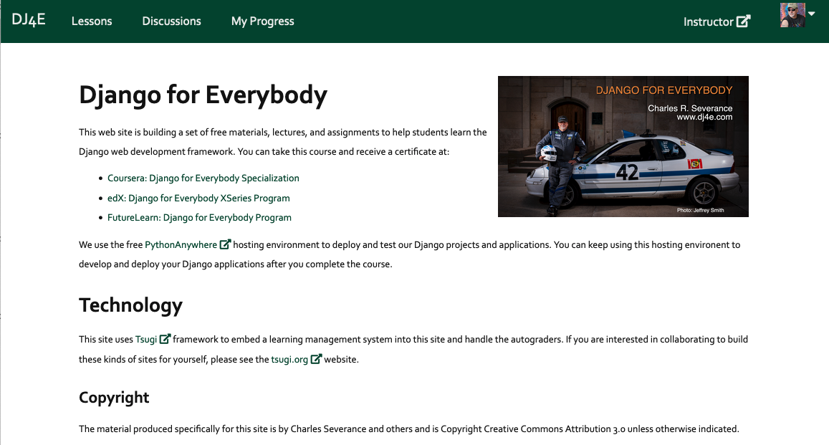
www.dj4e.com

Slide 22
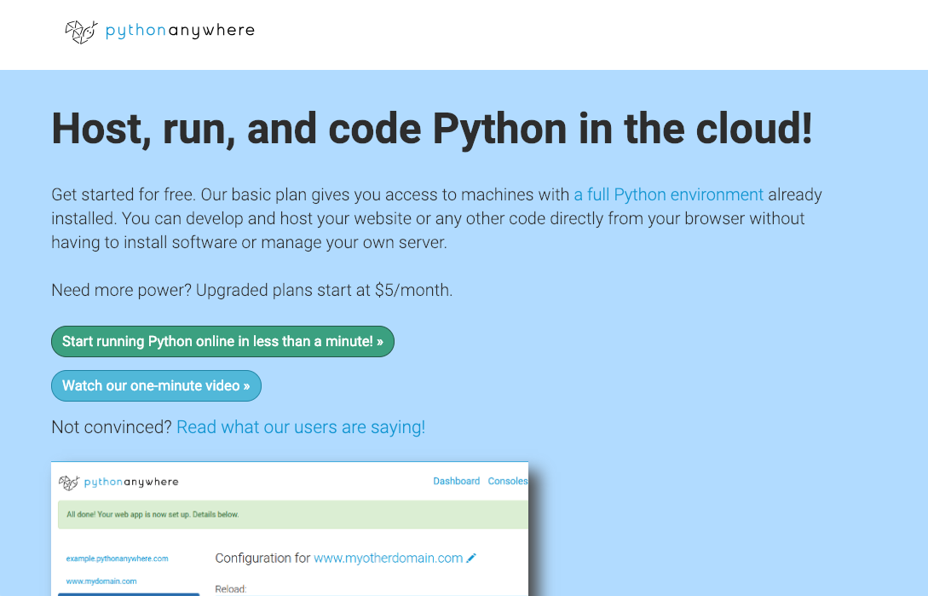
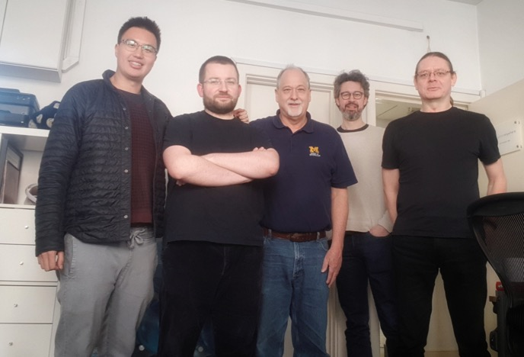

Slide 23
This course is open source
https://github.com/csev/dj4e
https://github.com/csev/dj4e-samples
https://www.tsugi.org
https://github.com/tsugiproject/tsugi
https://github.com/tsugiproject/tsugi-php
https://github.com/tsugitools/peer-grade
Written in SQL, PHP, JavaScript, Jquery, Django…

Slide 24
Grading
Programming Assignments / Quizzes 50%
Midterm exam: 25%
Final exam: 25%
Late assignments will be penalized by 20% times the number of days late. Homework that is 5 days or more late will receive zero credit.

Slide 25
Grading Assignments
Sometimes we will use automated computer grading for software
Unlimited tries / lots of feedback / immediate score in Canvas
Sometimes we will use peer grading
Submit your assignment
Grade other students
Course staff

Slide 26
How a Week Works
Lecture (Friday)
Reviews previous weeks assignments (after the due date)
paints a big picture of the "big idea" of the next week's assignment
Assigns new assignment – Due six days later (Thursday @11:59PM)
Weekend
You should make progress on the assignment (or even complete it)
Discussion
You should get un-stuck and make sure that you really know the material in the Assignment
Thursday @ Midnight – Assignment due – don't expect Instructor/GSIs to answer any email after 5PM Thursday.

Slide 27
Lectures??
Online / Synchronous
Recorded (mostly)
Attendance is not taken

Slide 28
Discussion Sections (Regular)
F2F + Online + Synchronous + Recorded
Best way to get instant feedback
Can be boring to watch recording
Might include short presentation from the GSI
Working through sample code from lecture
Filling in missing bits
Intended to meet *your* needs
Semi private if you participate

Slide 29
Discussion Section 664-004
Designed as an "overflow" discussion section to allow the course to be expanded to meet demand
All online
For students that need less help and won't fall behind

Slide 30
Office Hours
Synchronous + Not Recorded
Usually focused on me figuring out some broken part of the course software
I will be in my office working – video and audio might be off – just say "hi"

Slide 31
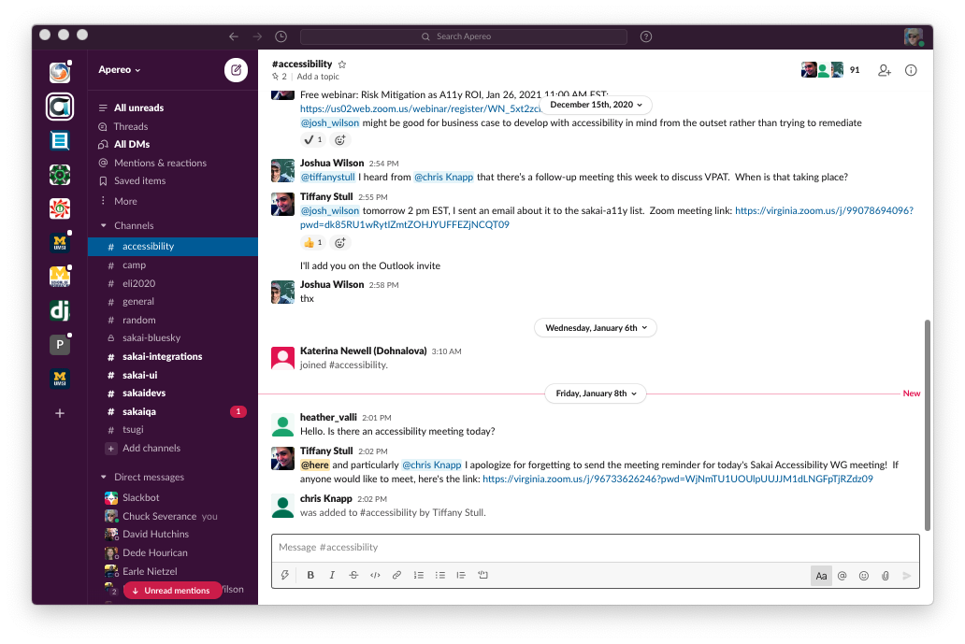

Slide 32
Slack – Not Official – Not required
We made a slack channel for your convenience
You do not have to join
There will be no required information or communication in Slack
You can use Direct Messages in Slack
If you are not using DM, other students may "overhear" what you say
Semi-public

Slide 33
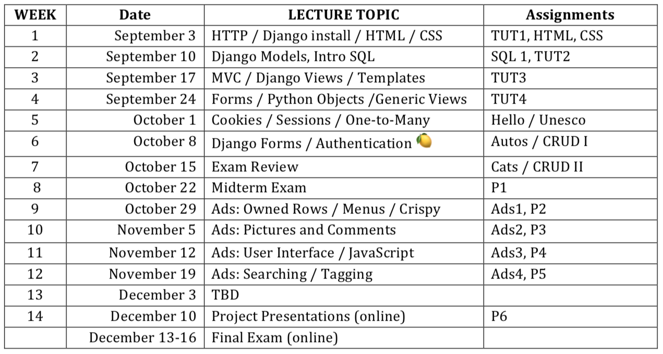

Slide 34
Practical Midterm Exam
Write a Django application in 2 hours
It will be auto graded so you can test as many times as you like
It will not be as difficult as the "CRUD" programming assignment
You will be given a practice exam that is *very similar* to the real exam

Slide 35
Final Exam – Code Escape Room
You will get source code and a URL
The rest is up to you
There will be a practice exam to help you to experience an escape room

Slide 36
Final Grade Computation
Straight scale from written syllabus
A+ will be awarded for extraordinary work
Not just a high percentage of points - that is a pre-requisite for A+
Going beyond the specifications - doing more...

Slide 37
Health and well being
See the syllabus for details and contact information to get help
The main point is that there are people there to help you
We encourage you to make use of these resources
You can always send email to csev@umich.edu for issues that are personal and private

Slide 38
Welcome to the course...
Any questions?

